Slide 1
Shiny Workshop Day 1
August 27, 2019
TEA Analytics

Slide 2
Environment Settings

Slide 3
To-Do List
Check the installation of needed apps
R
Rstudio
Download zipped files and save it at Desktop
https://github.com/TEA-Analytics/ShinyWorkshop/releases
Install packages
01_InstallPackages.r
Get a cheatsheet.

Slide 4
Disclaimer
This workshop is designed solely with Eina’s biases and skewed personal experiences dealing with r and rshiny.
Eina does not claim the latest knowledge in r shiny, nor the current best practices.
Please know that R community has been evolving rapidly, Eina – who started R coding before tidyverse era – is a bit old-fashioned, and this does not mean Eina is discouraging anybody from adopting the latest trend in R.

Slide 5
Shiny Basics Review

Slide 6


UI and Server
Server
UI
Give me this.
Here it is.
I know how to compute.
I know how to display.
“UI” specifies layout of the app and requests things to a server when needed.
“Server” gives requested whatever (plot, table, …).
Both UI and server are within R.

Slide 7
Server and Shiny-Server
“Server” may refer to the server section of the app.
“Shiny Server” may mean an actual web server that hosts shiny apps.
Topics of deployment will be covered tomorrow.
You have to know the context for knowing which one means.

Slide 8
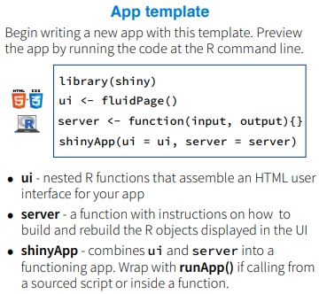
File structures
Many examples online will have everything in one script using shinyApp().
For a small app, it’s easy to see.
Our default file structure is to break it down to 3 (or more) files:
Ui.r
Server.r
Global.r (Optional)
All these 3 files needs to be in a same folder.
runApp(‘foldername’)

Slide 9
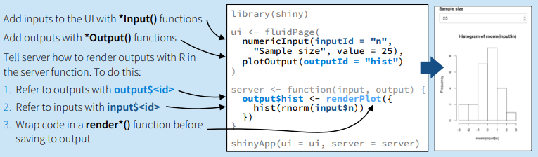
Basic Code Structures
For each input, a unique id is given, and values are available in the server as Input$inputId.
UI requests * when it encounters *Output(), identified by outputId. Server returns output$*.
Make sure *Output() and render*() are matching, as well as object inside render*().
Reference
Shiny Widget Gallery (https://shiny.rstudio.com/gallery/widget-gallery.html)

Slide 10
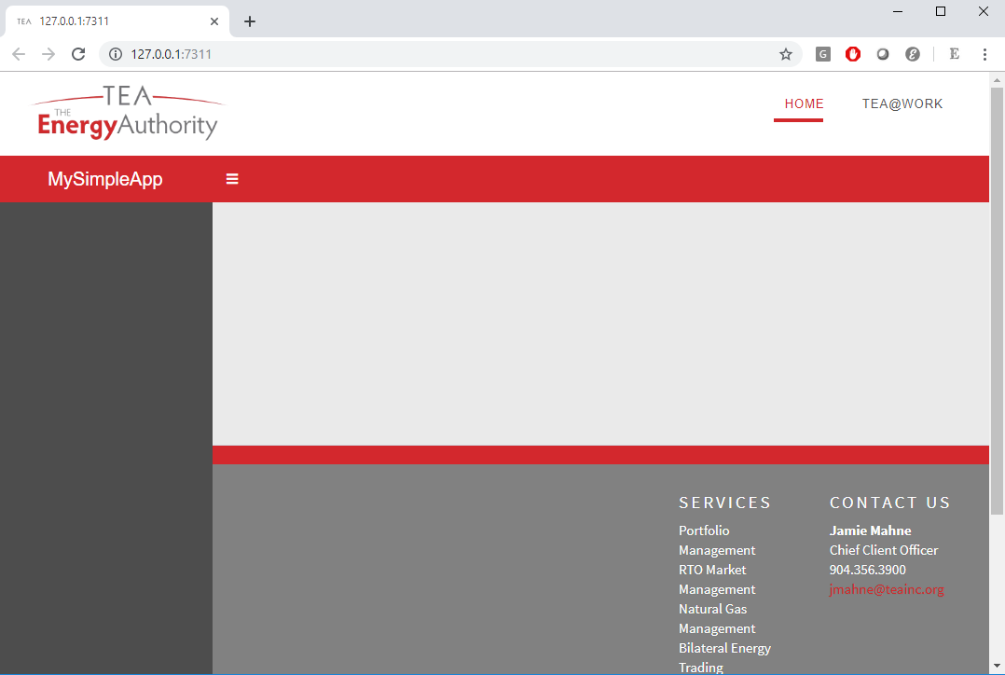
‘teadashboard’ TEA-version of ‘shinydashboard’
In general, we recommend using the ‘teadashboard.’
All functionalities are the same with shinydashboard.
Open “TheSimplest” template and run it.
The RunApp button.

Slide 11
Exercise 1
Run the simplest template.
Break it down to 3 files.
Create a app folder.
Ui.r, server.r, and global.r.
Add the following:
Read in SPP data in ‘Data’ folder.
Add a section (menuitem)
Add a date range selector
Add time series plot
Add a table.
Hints
Read.csv
menuItem
dateRangeInput
plotOutput/renderPlot
dataTableOutput/renderDataTable

Slide 12
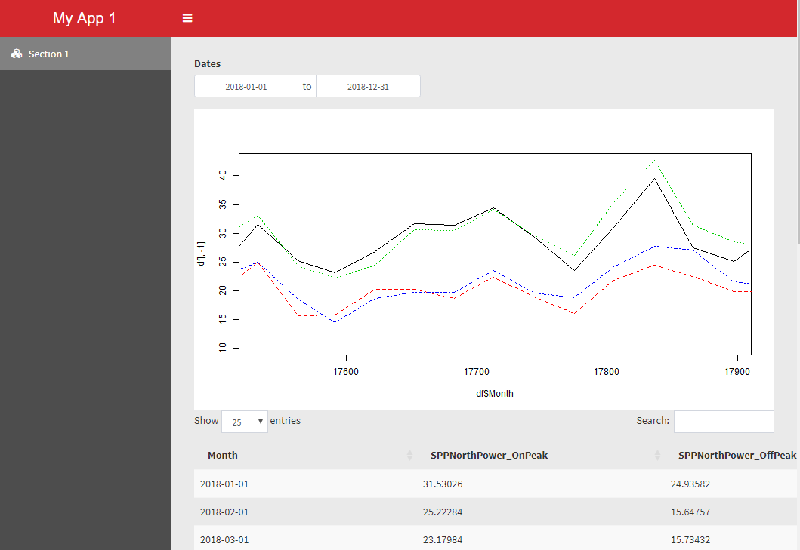
Exercise 1

Slide 13
Exercise 2
Add box() for objects in the body
Make the data dependent on “market”.
Create a selector for market in the sidebar and make “SPP” and “CAISO” available.
Create a reactive object for data.
Hints:
selectInput
Reactive

Slide 14
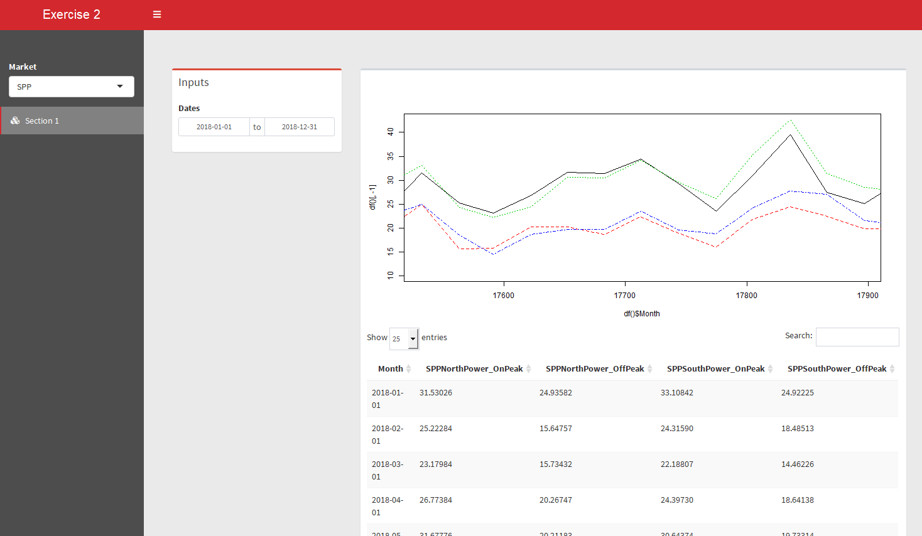
Exercise 2

Slide 15
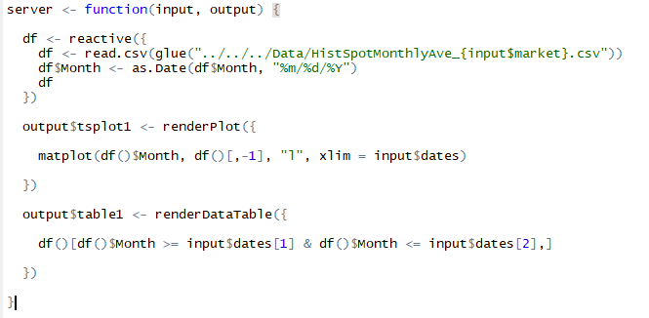
Reactive?
Reactive objects live in reactive environments.
Reactive objects
Input$xxx
Reactive()
reactiveValue
Reactive Environments
Inside render*
Inside reactive*
Inside observe*.

Slide 16
Layout

Slide 17
Layout
Always use boxes.
Use fluidRow and columns for dividing the page.
Within the divided section of the page, width is specified over 12.
Height specification optional.
Box (3)
Box (width = 9)
Fluid row
Box (6)
Box(4)
Box (width = 12)
Fluid row
Box(12)
Column (width = 8)
Column (column = 4)

Slide 18
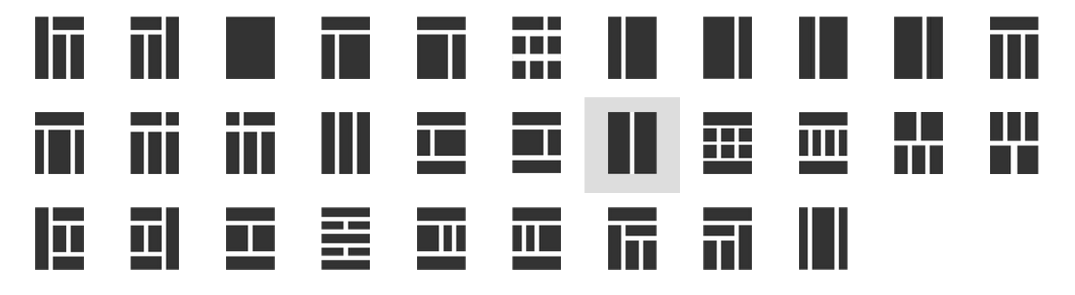
Examples
1
3
2

Slide 19

Exercise 3
Add anther section (menuitem) and add boxes like this:
Add some texts in a box using tags$xxx.
Open the ‘TEABranded’ template and notice
A few different layouts
Sidebar submenues
User longin.
“About” page
Check out icons
https://rstudio.github.io/shinydashboard/appearance.html#icons

Slide 20
Tour of Existing TEA Shiny Apps

Slide 21
LMP Forecast
https://analyze.teainc.org/LMP-Forecast-Main/
Notice
Progress Bar
Select Inputs with multiple choices
Interactivity with htmlwidgets
Ability to update data and rerun the model.
Interactive Maps

Slide 22
DeltaHedging
https://analyze.teainc.org/DeltaHedging/
Notice
Excel like look and feel.
Base shiny interactivity
Database connections (read/write)

Slide 23
HedgeFox
https://analyze.teainc.org/HedgeFox/CAISO/
Notice:
Subfolder structures
Hidden tabs
Disabled inputs.
Use of information boxes.
Rmarkdown reports.
Synched up date-pickers.

Slide 24
Understanding Reactivity

Slide 25
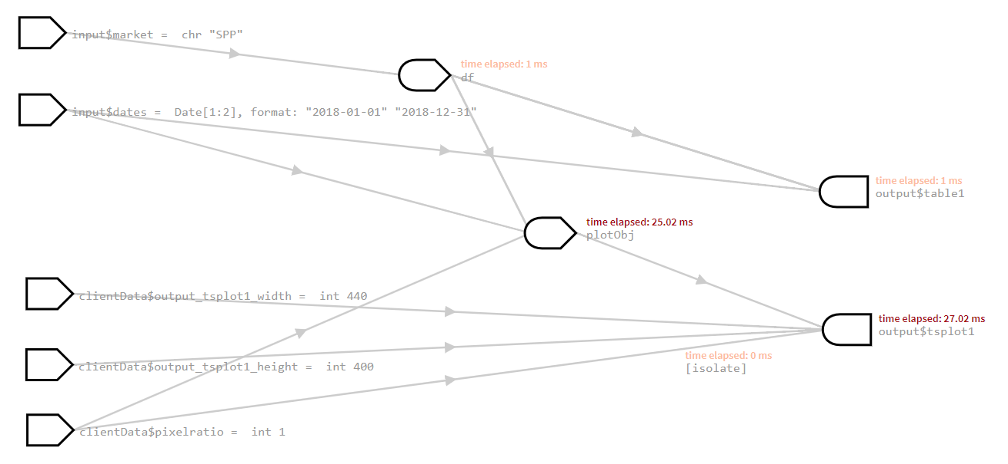
Our First App
Reactive value
Reactive expression
observer

Slide 26
When a Page is Opened
Reactive value
Reactive expression
observer
Follow the arrow backward for UI requests.

Slide 27
When a Page is Opened
Reactive value
Reactive expression
observer
Follow the arrow forward for updates of requested.

Slide 28
When Input Changes 1
Reactive value
Reactive expression
observer
Invalidated
Follow the arrow forward for “Invalidating”

Slide 29
When Input Changes 1
Reactive value
Reactive expression
observer
Invalidated
Update values if they are requested by UI. (Lazy reactivity).

Slide 30
When Input Changes 2
Reactive value
Reactive expression
observer
Invalidated
Invalidated

Slide 31
4. Demo
options(shiny.reactlog=TRUE)
If TRUE, enable logging of reactive events, which can be viewed later with the showReactLog function. This incurs a substantial performance penalty and should not be used in production.

Slide 32
Objects
R objects
Data frames
Arrays
Functions
List
…
Reactive ← Think this like a function
ReactiveValues ← Think this like a list.

Slide 33


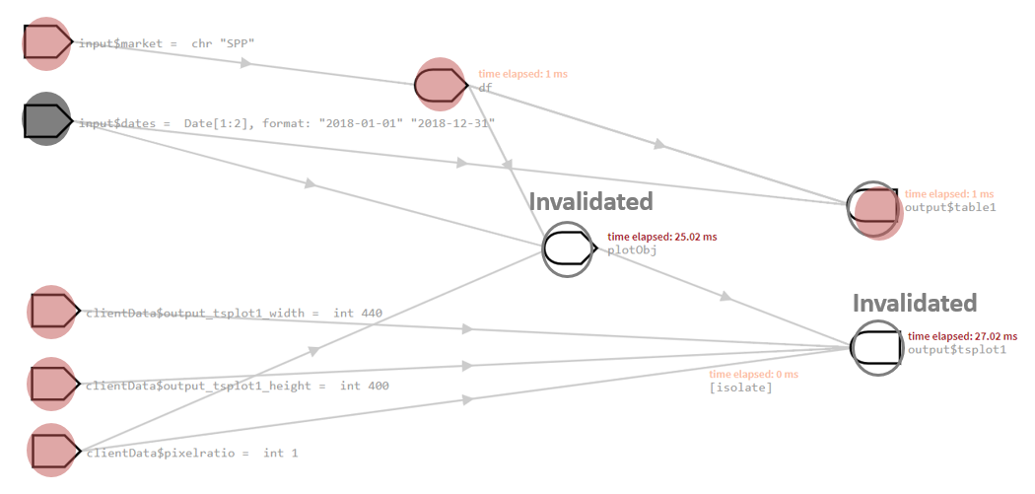
Reactive as a Function with Memory
Functions
Computes every time it’s called.
Reactive
It caches values.
It knows when inputs change.
It returns cached values if inputs haven’t changed.
V.S.

Slide 34
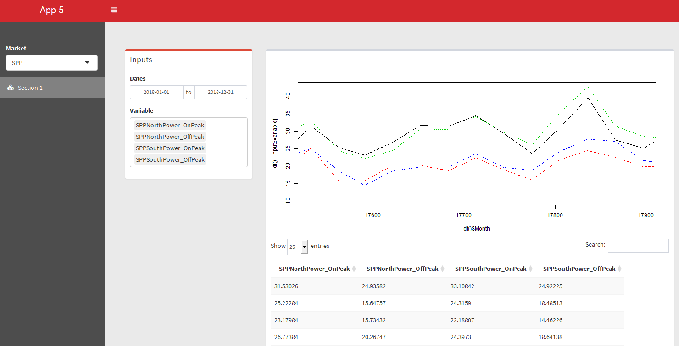
5. Exercise
Add a input selector where you can choose which prices to show.
selectInput(multiple = TRUE)
uiOutput/renderUI
Show reactivity log.

Slide 35

5. Exercise
Observe:
Reactivity can become complicated fast, if you use particular objects in the app.
Dynamic UIs
rhandontable
We don’t have to worry about reactivity, until we have to.
A flash of error message.

Slide 36
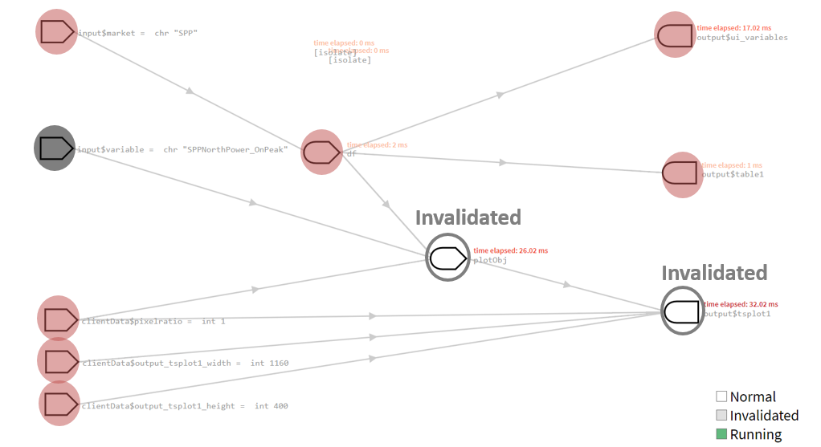
Control Dependencies
Req() & validate(need())
Ensure that values are available before proceeding with a calculation or action.
Add reactive objects.
Create dependency
Isolate()
Avoid dependency.
EventReactive()
Specify the dependency.

Slide 37
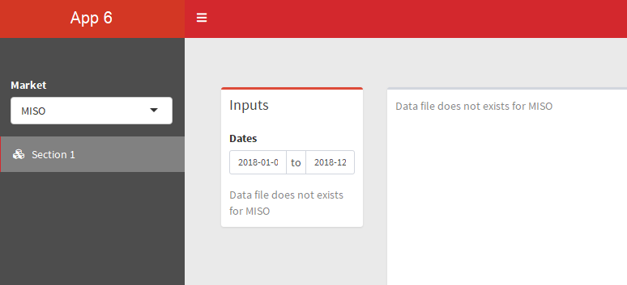
6. Exercise
Add req() for dymanic UI variable.
Add another market “MISO” and validate() for checking if the data source exists.

Slide 38
Observers
Observe: watches for all dependent reactive objects.
observeEvent: reacts to only specified reactive objects.
Behaviors
Triggered every time one of its inputs changes (regardless of whether values are needed).
Yields no output.
Useful in
Reset input$xxx values using ‘update*Input’ functions.
Display pop-up messages.
Modifying reactiveValues
…

Slide 39
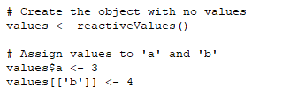
ReactiveValues
ReactiveValue is
Updated and/or called inside
reactive expression or observer.
You need to control when it updates.
No automatic updates when dependencies change.
It can be updated even when outputs are not needed.
Recall ‘reactive’
You don’t have to worry about dependencies.
Unless manually controlled, it’ll know the dependencies.
It updates only when needed.

Slide 40
7. Demo
Observe and reactiveValues

Slide 41
Use Cases for ReactiveValues
Need to store status and status changes based on multiple inputs
Partial data imports and append.
Append data as needed.
Examples:
https://github.com/TEA-Analytics/HedgeFox/blob/master/RCode/shiny-app/Common/server.r#L514
https://github.com/TEA-Analytics/DeltaHedging/blob/master/RCode/shiny-app/server.r#L61
https://github.com/TEA-Analytics/LMP-Forecast/blob/master/LMP-Forecast-Main/server.R#L7

Slide 42
Summary on Reactivity
First, think reactive.
Then think req, validate, isolate or eventReactive.
Then think reactiveValues with observe.
More control over dependencies.

Slide 43
Table Choices

Slide 44

Table Choices
Datatable (DT) – base shiny
https://rstudio.github.io/DT/
Formattable
https://renkun-ken.github.io/formattable/
Beautiful display
Rhandsontable
https://jrowen.github.io/rhandsontable/
Easy user input table.

Slide 45
8. Exercise
Change the data table to something fancy.

Slide 46
Interactive Plots

Slide 47
Approaches
Use htmlwidgets
https://www.htmlwidgets.org/
Leaflet
Dygraph
Plotly
Use base Shiny
https://shiny.rstudio.com/gallery/plot-interaction-basic.html
https://shiny.rstudio.com/gallery/

Slide 48
9. Exercise
Use Dygraph for tsplot.
Dygraph takes xts objects. Load both dygraph and xts libraries.
Convert data frame into xts before feeling into the dygraph function.

Slide 49
Miscellaneous Tips

Slide 50
session
Optional argument in server function.
Needed when
Accessing user info
Using module.

Slide 51
Download

Slide 52
Progress bars

Slide 53
Hiding Items
Hide Tabs
Shinyjs

Slide 54
Rmarkdown Report

Slide 55
Shiny vs Tableau

Slide 56
Shiny Pros vs Cons

